Slide 1
TEAM 3 – Health Technology COVID Discourse: Social Media
Team Members
Hard Thakkar
Shuaib Ali Khan Mayana
Sai Thejaswin Reddy Loka
Suvaleena Paul
Sai Prudhvi Chand Jammigumpula

Slide 2
AGENDA
Topic Modeling: LDA
Topic Contributions – BERT
Sentiment Analysis
Emotion Analysis
Sentiment Analysis (Team 3 & Team 4)

Slide 3
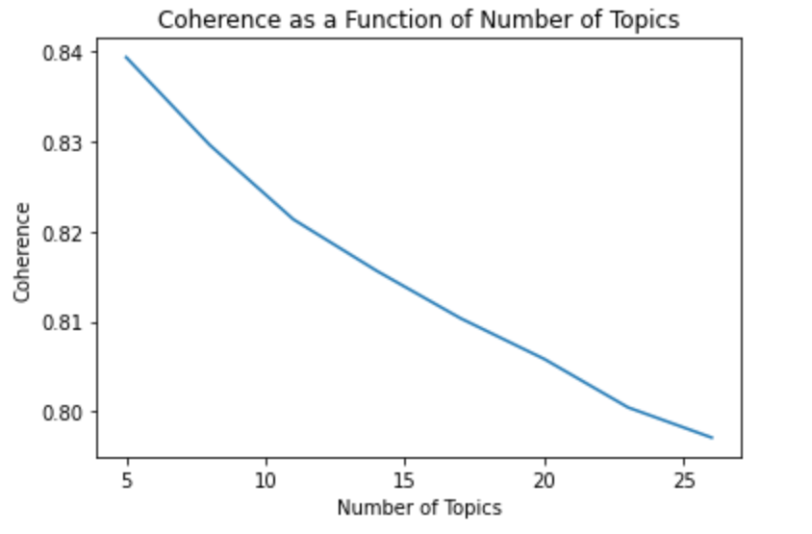
LDA - using Gensim
Extracted a Coherence Score for topics ranging from 5 to 26
Highest coherence score = 5

Slide 4
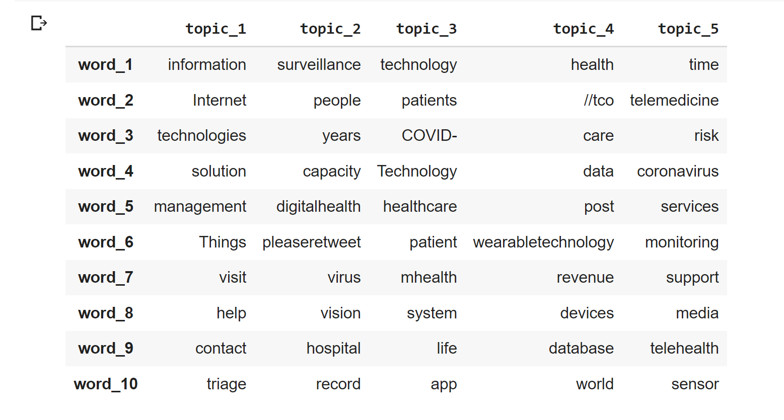
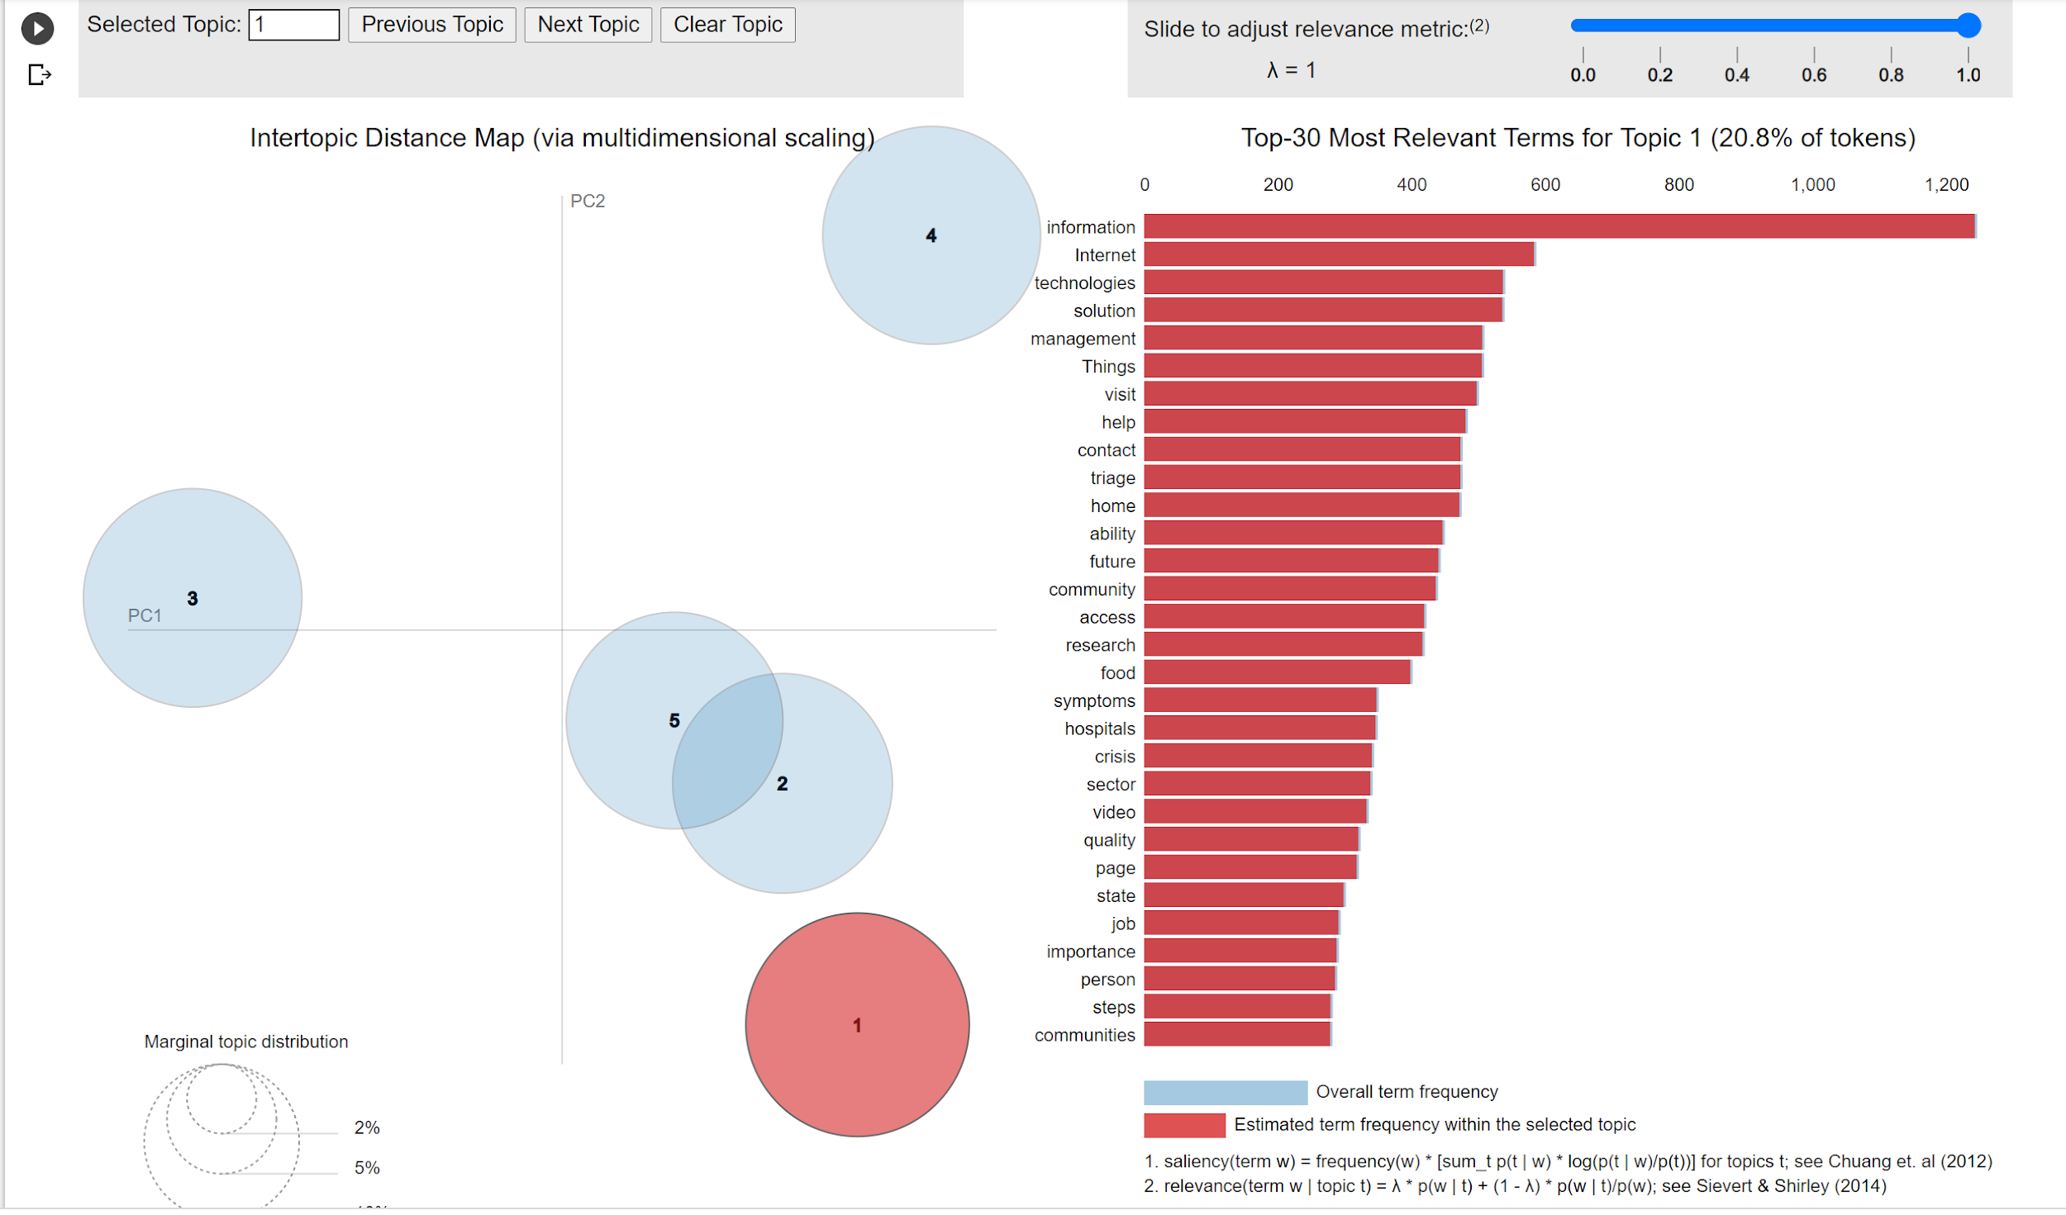
PHASE 1 - July’ 19 to Dec’19
Topic 1: Online shared information
Topic 2: COVID cases, Tech Surveillance
Topic 3 & 5: Telehealth COVID services

Slide 5
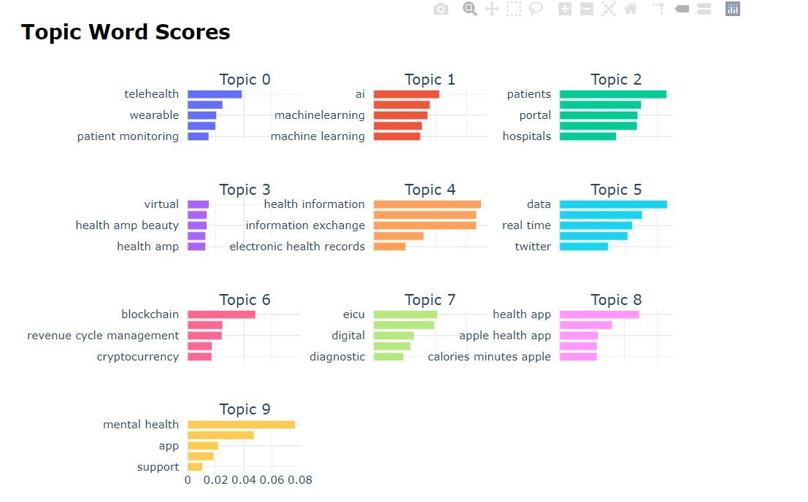
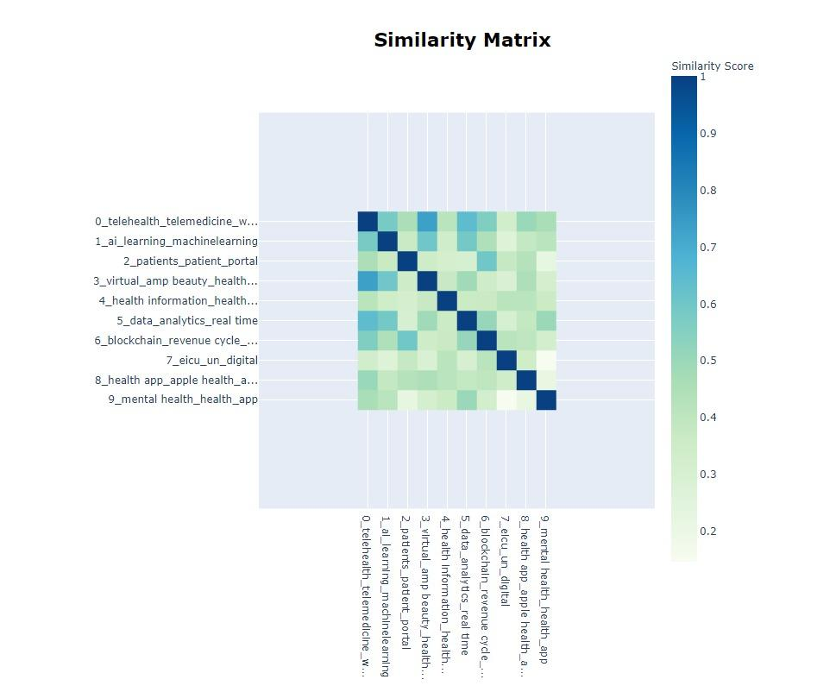
PHASE 1 - July’ 19 to Dec’19

Slide 6
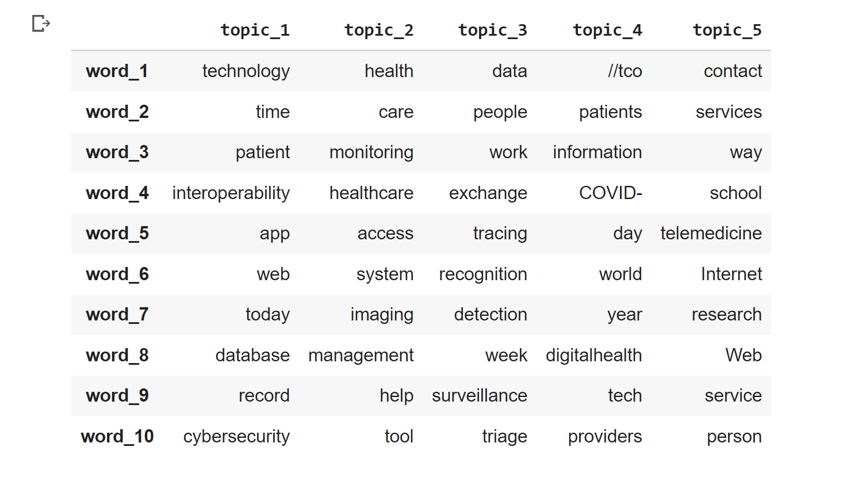
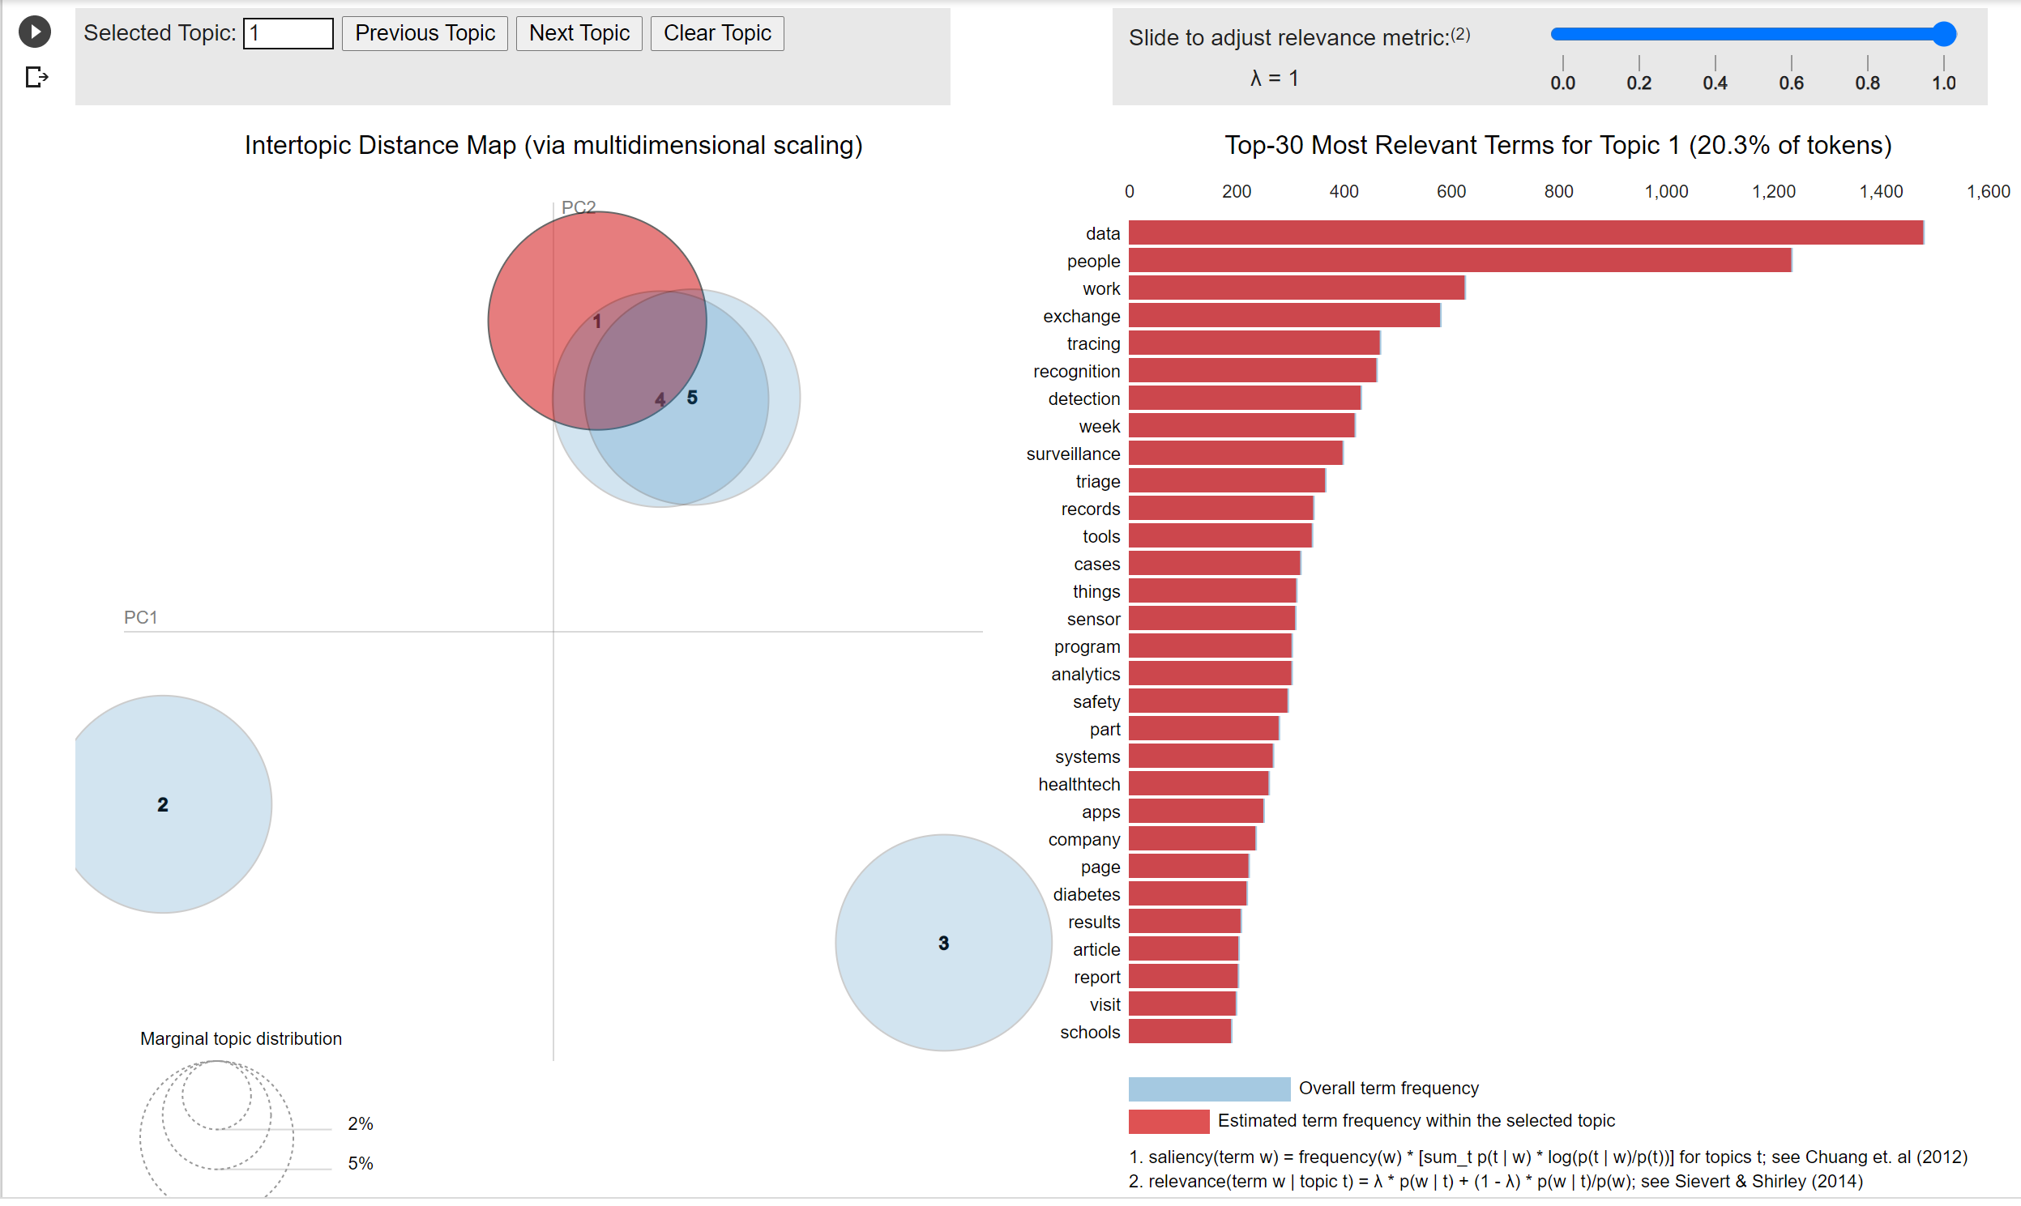
PHASE 2- Jan’ 29 to June’ 20
Topic 1 & 5: Interoperable access to health data
Topic 3: Detection and Recognition surveillance
Topic 4: Patients' information for each day, hyperlinks to sites that might provide information regarding patients' info

Slide 7
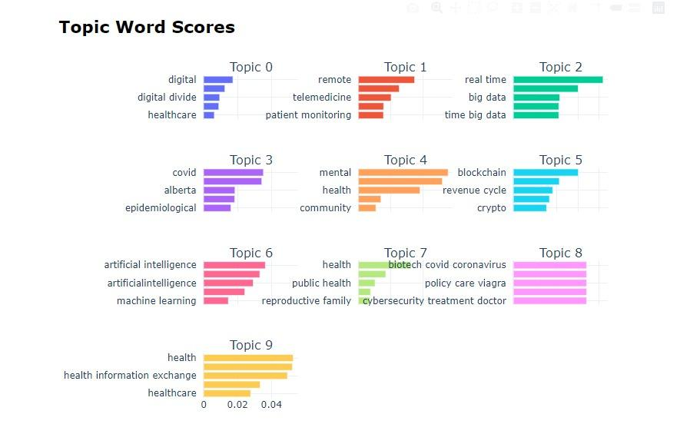
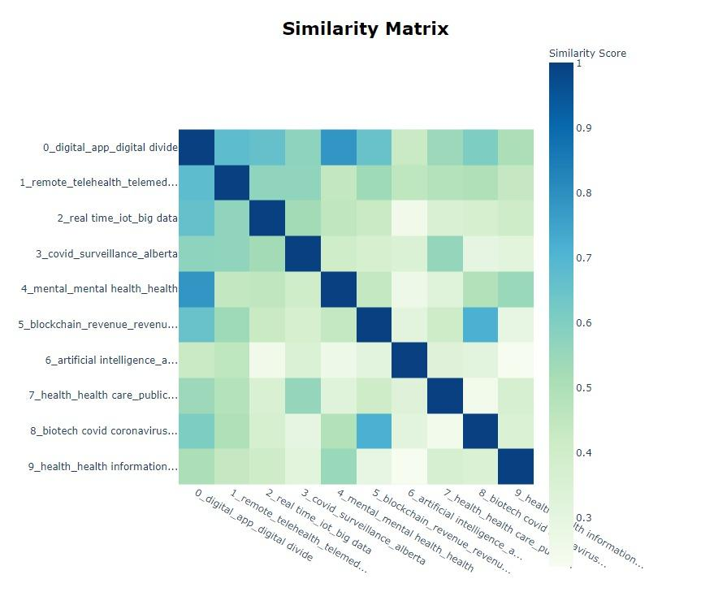
PHASE 2- Jan’ 29 to June’ 20

Slide 8
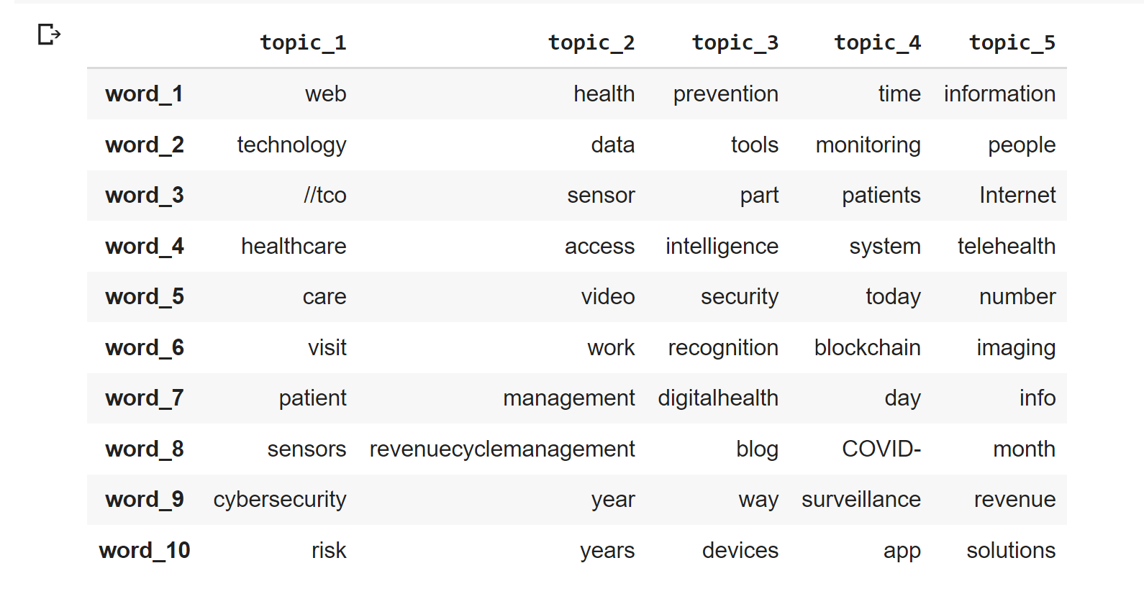
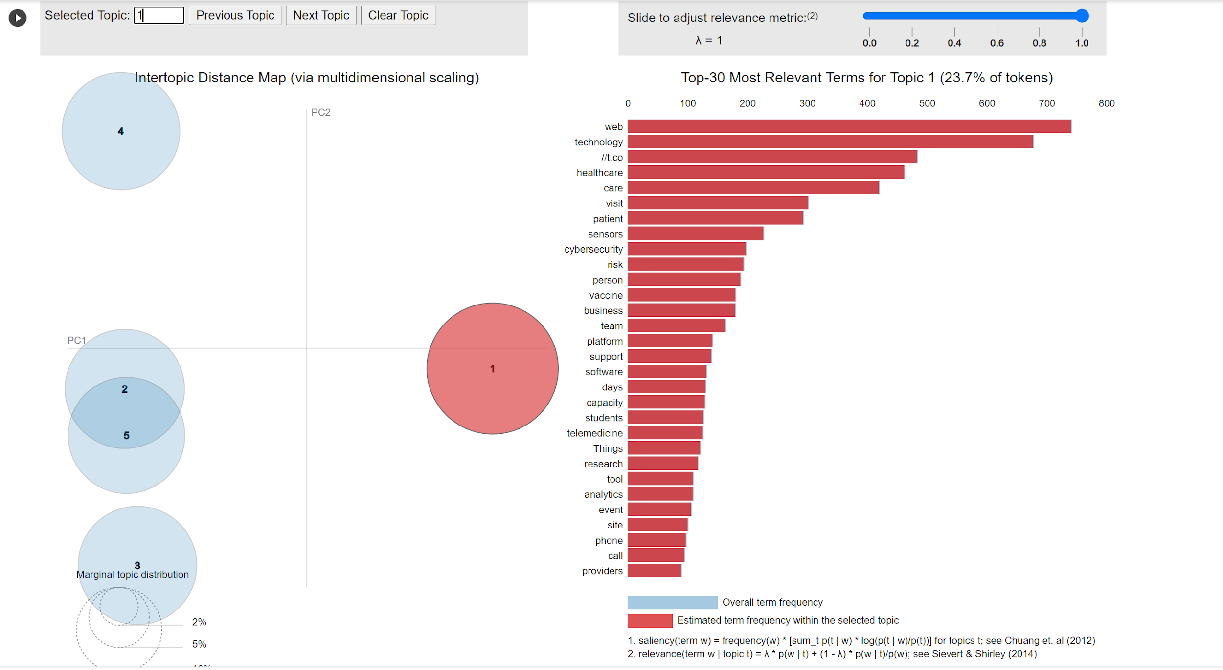
PHASE 3 - July’ 20 to Nov’ 20
Topic 1: Web Technology sites/links
Topic 2 & 5: Access to telehealth info, revenue management

Slide 9
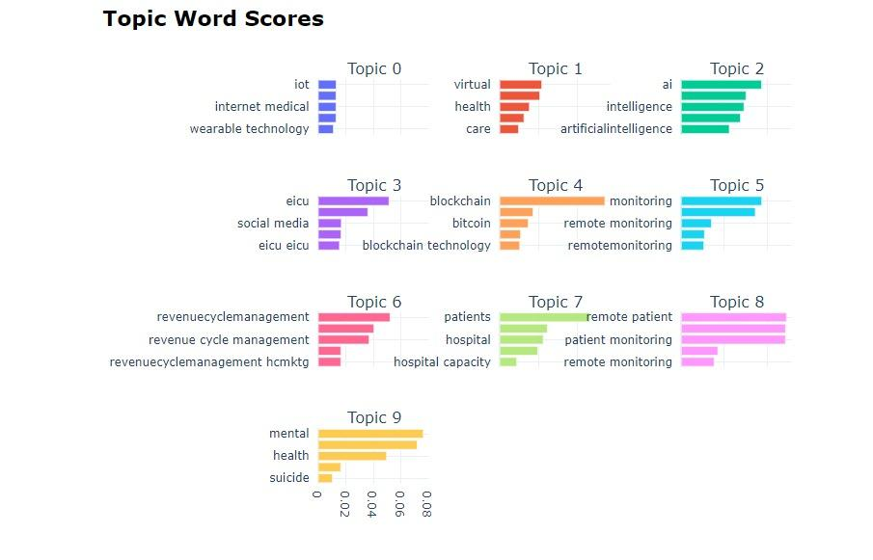
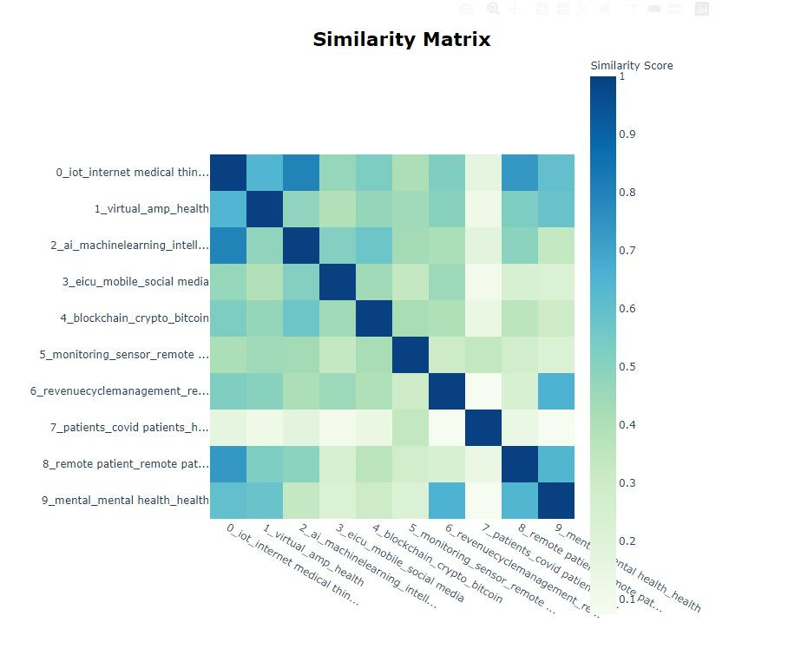
PHASE 3 - July’ 20 to Nov’ 20

Slide 10
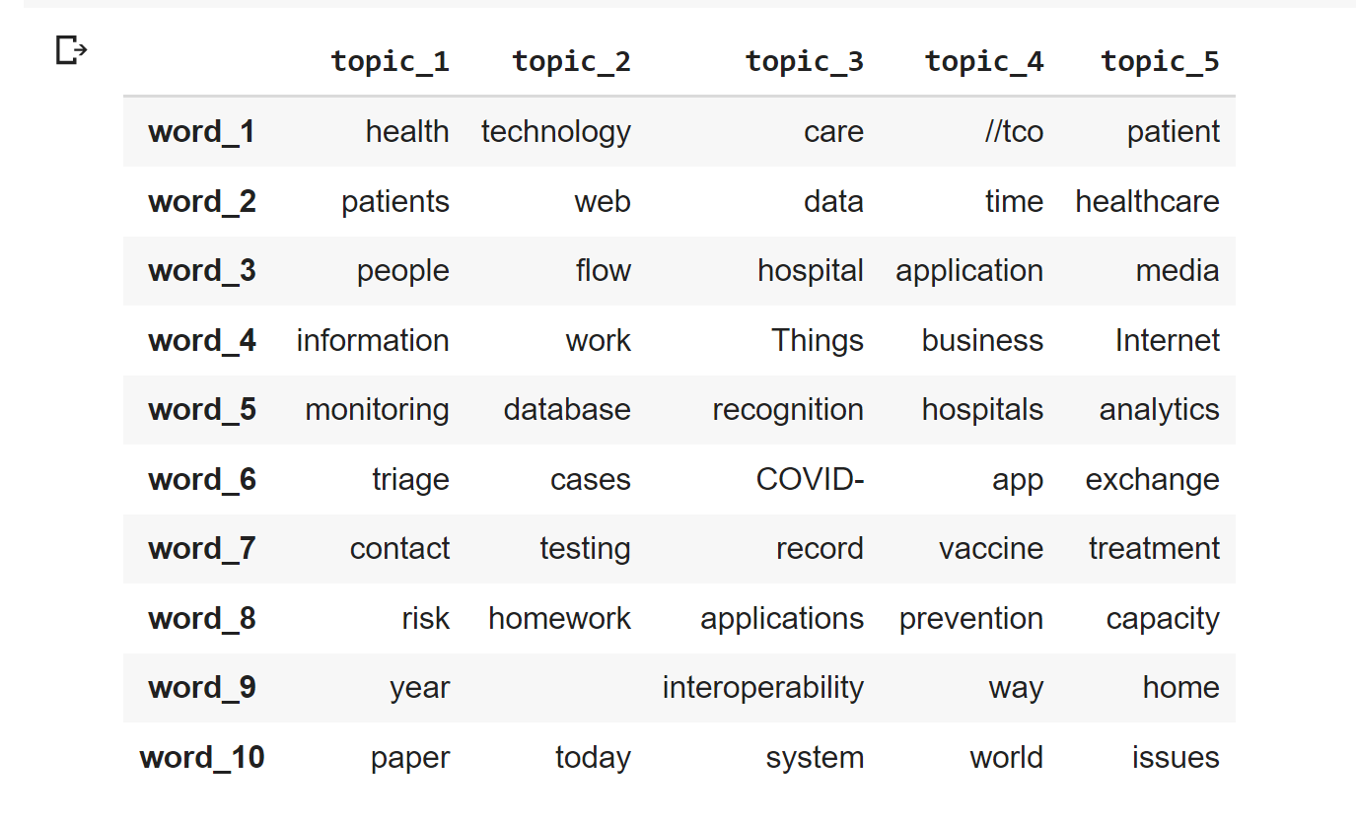
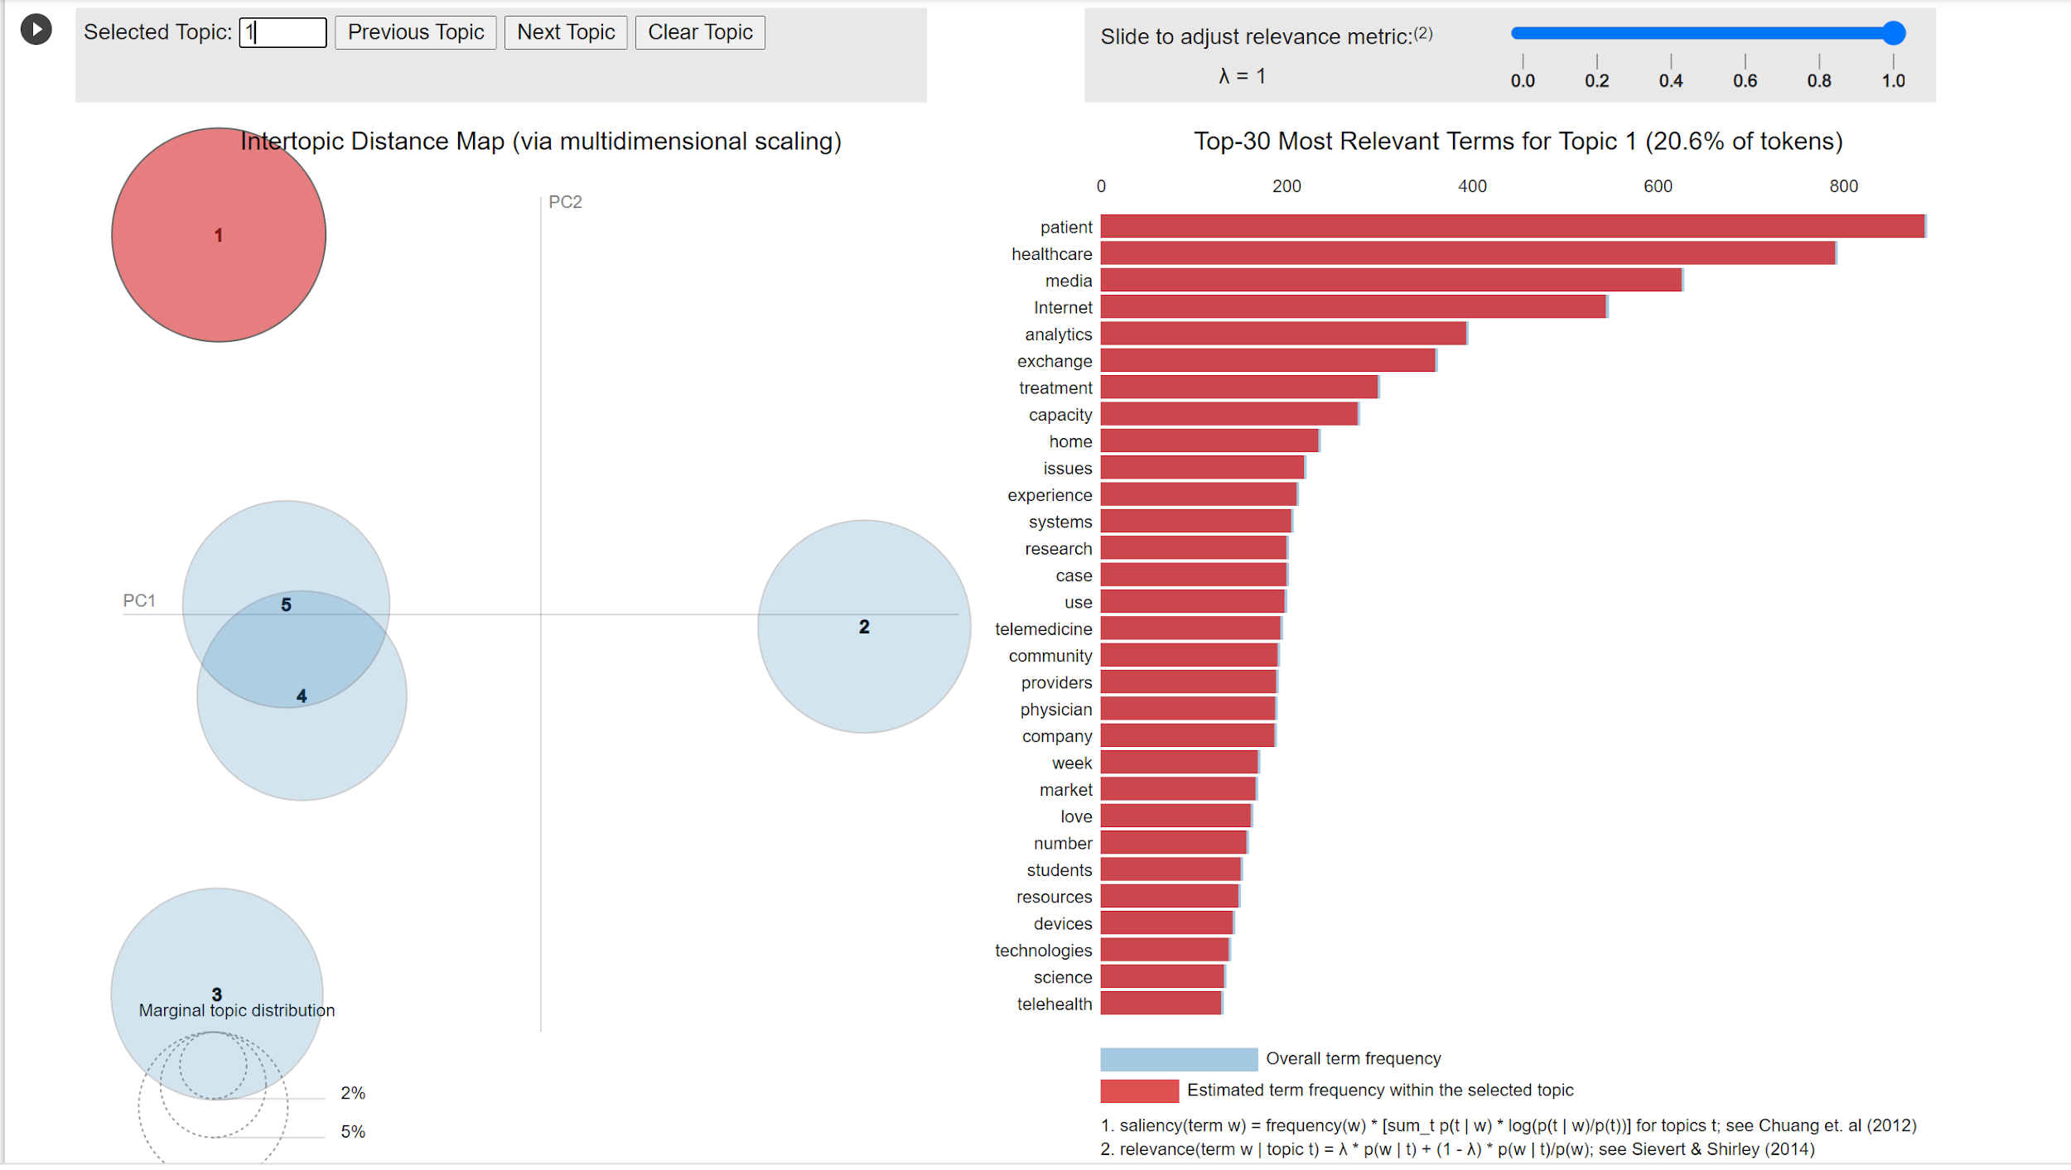
PHASE 4 - Dec’ 20 to May’ 21
Topic 1: Patients' monitoring
Topic 4: Vaccines and virus prevention
Topic 5: Patient treatment, analytics and media through internet?

Slide 11
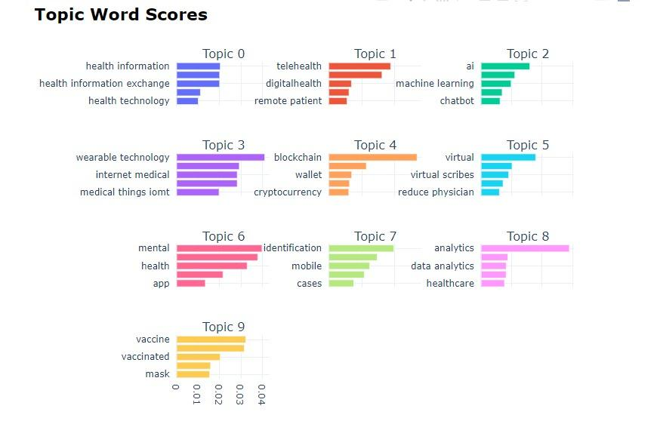
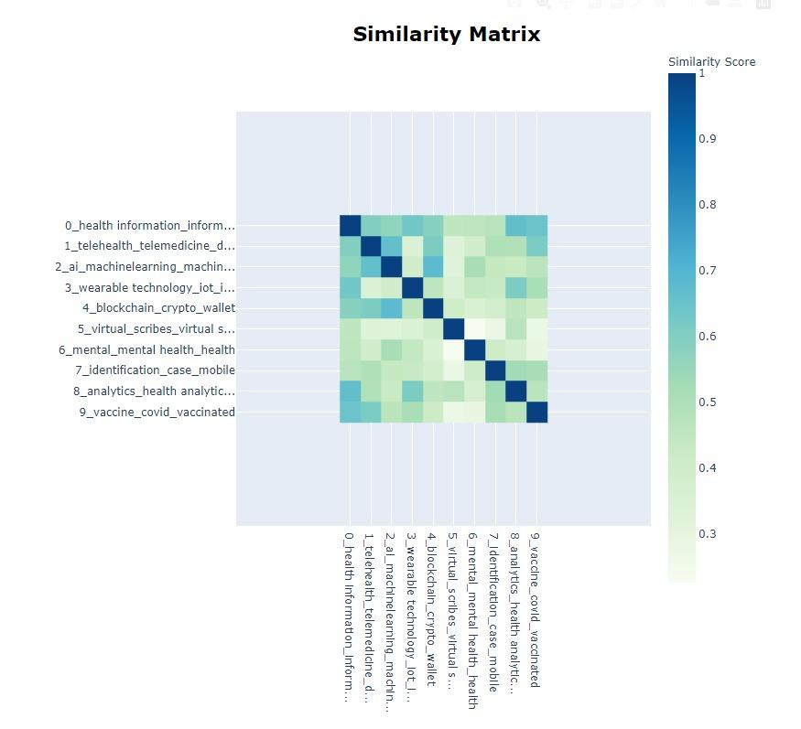
PHASE 4 - Dec’ 20 to May’ 21

Slide 12
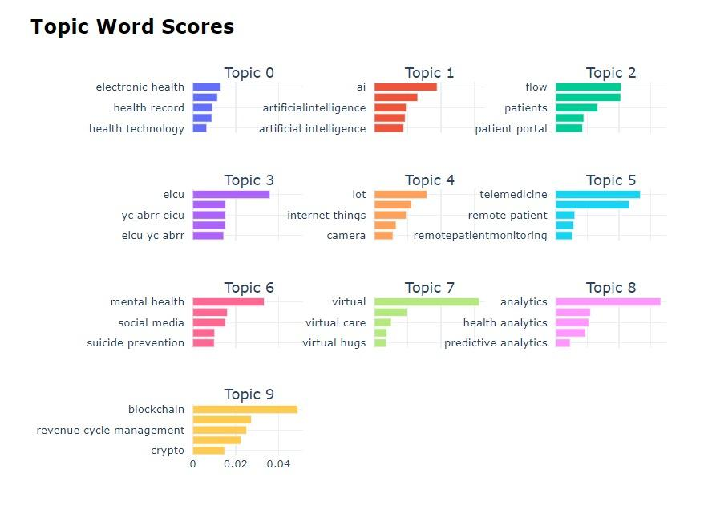
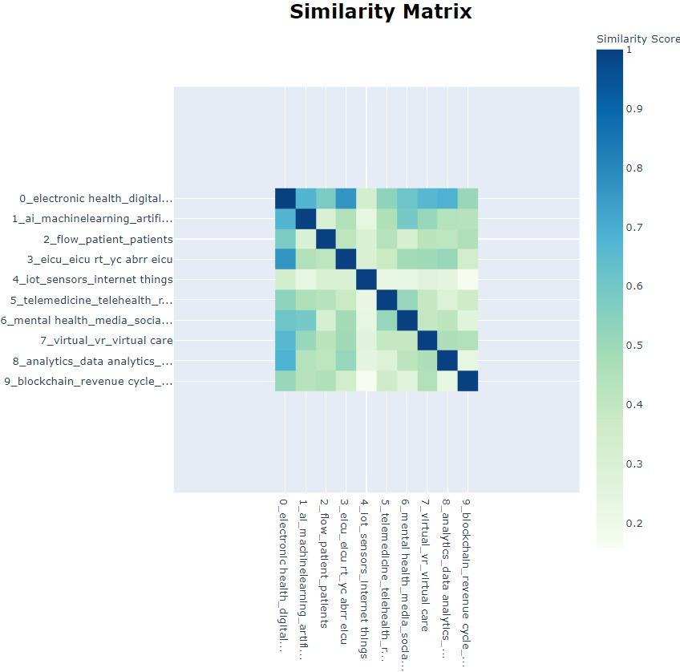
PHASE 5 - May’ 21 to Aug’ 21

Slide 13
Sentiment Analysis(Team 3)

Slide 14
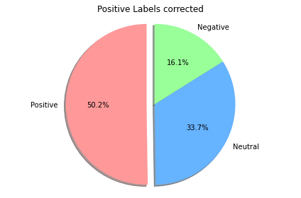
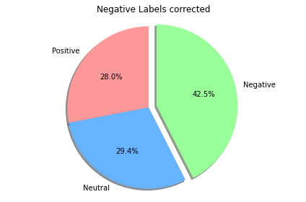
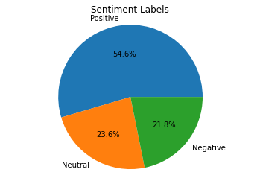
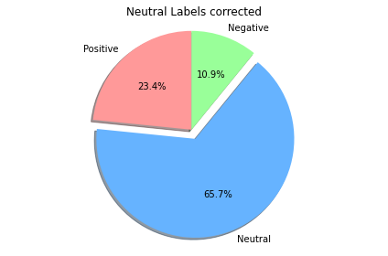
Sentiment Analysis Relabeling - Sentiment Distribution & Labeling Error Correction using Vader

Slide 15
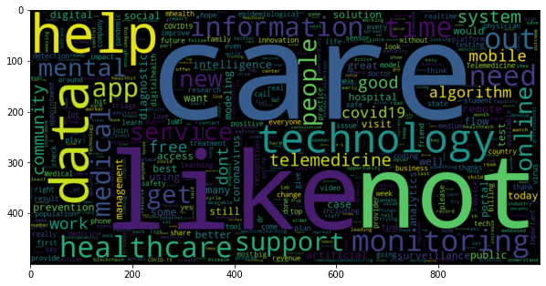
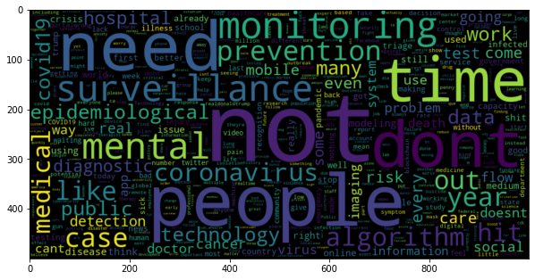
Sentiment Analysis - Word clouds
POSITIVE
Negative

Slide 16
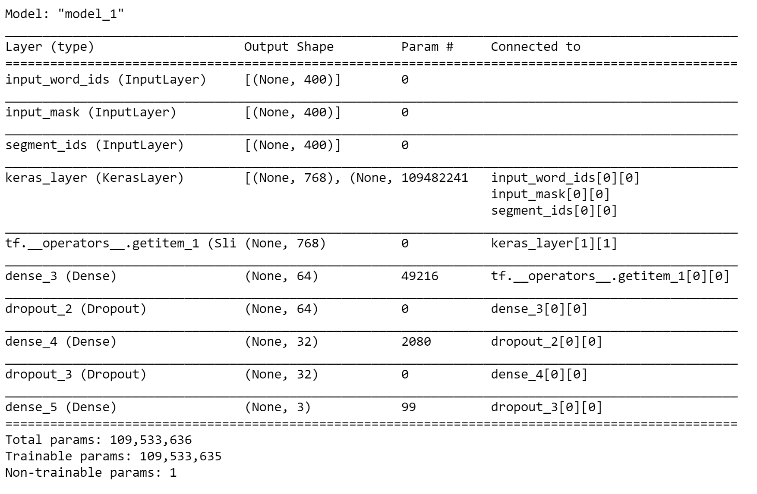
BERT model for Sentiment
‘Softmax’ activation function for Multi-Class classification
Loss Function: Categorical Cross entropy
‘Adam’ Optimizer

Slide 17
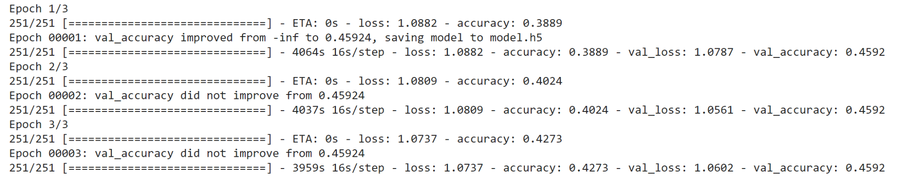
BERT - Results
Validation Accuracy < 50%

Slide 18
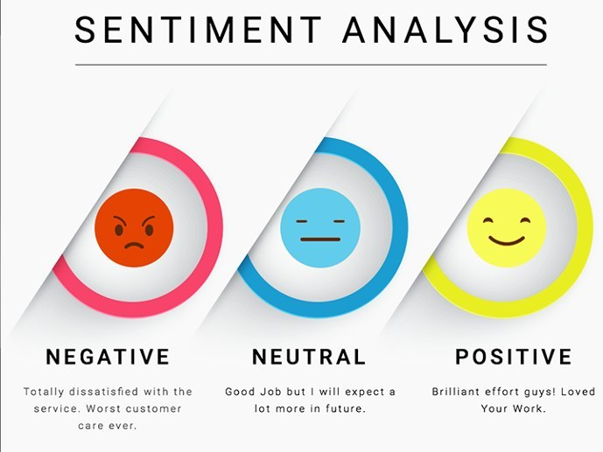
Sentiment Classification - Modeling
Vectors: TF-IDF
Split: 80:20
Stratification during train-test split - to ensure equal class-distribution
Multi-class classification problem:
○Logistic Regression
○Random Forest
○Linear SVC
○DistilBERT

Slide 19
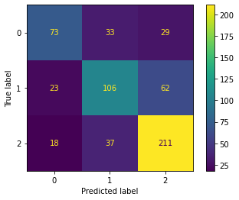
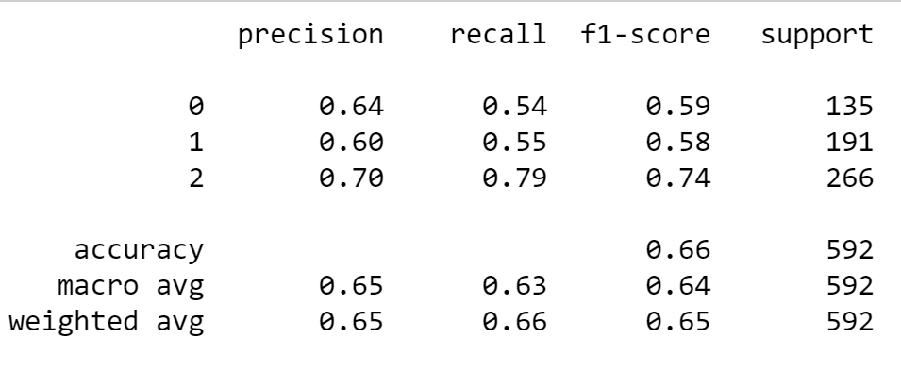
Results and Inferences - Initial
MCC Score: 0.46
0 - Negative | 1 - Positive | 2 - Neutral

Slide 20
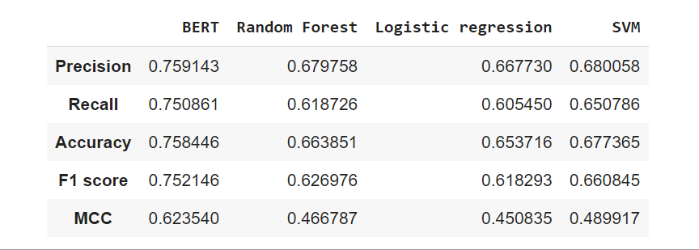
Results and Inferences - Final Results
DistilBERT outperforms all the models

Slide 21
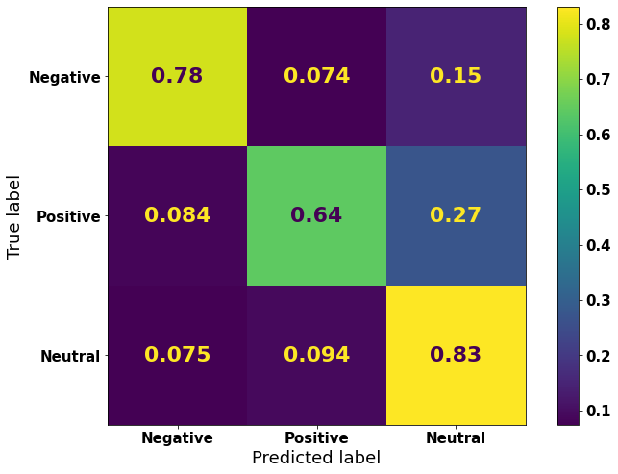
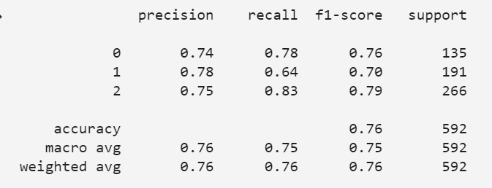
Results and Inferences - Best Model
MCC Score: 0.62

Slide 22
Sentiment Analysis(Team 3 & Team 4)

Slide 23


Phase-1
POSITIVE
Negative

Slide 24
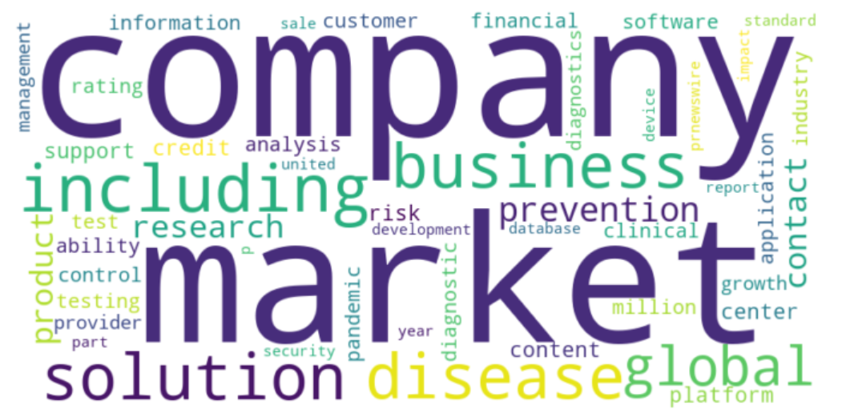
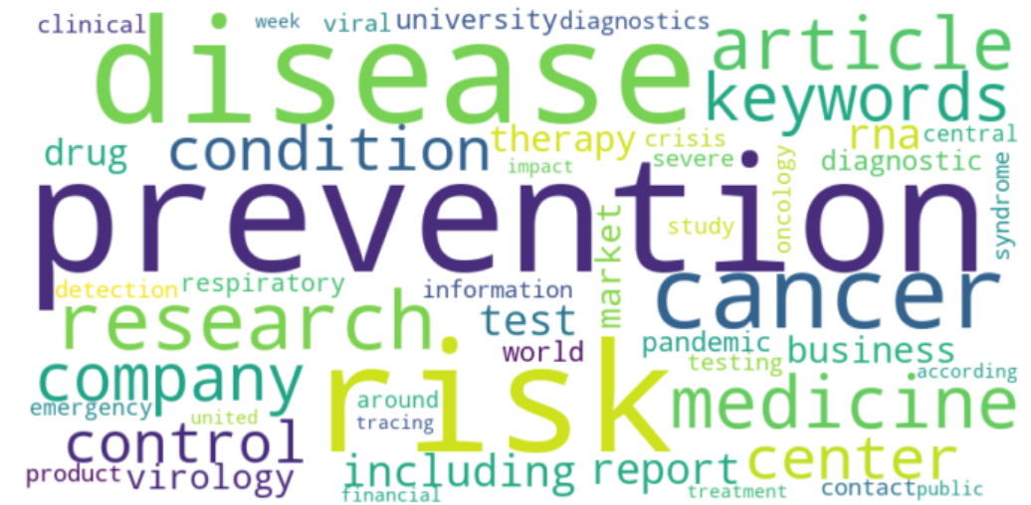
Phase-2
POSITIVE
Negative

Slide 25
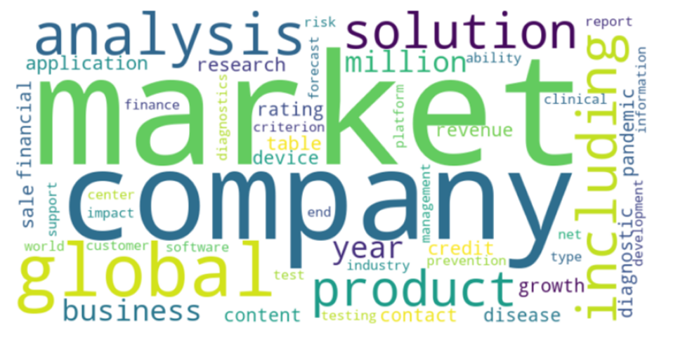
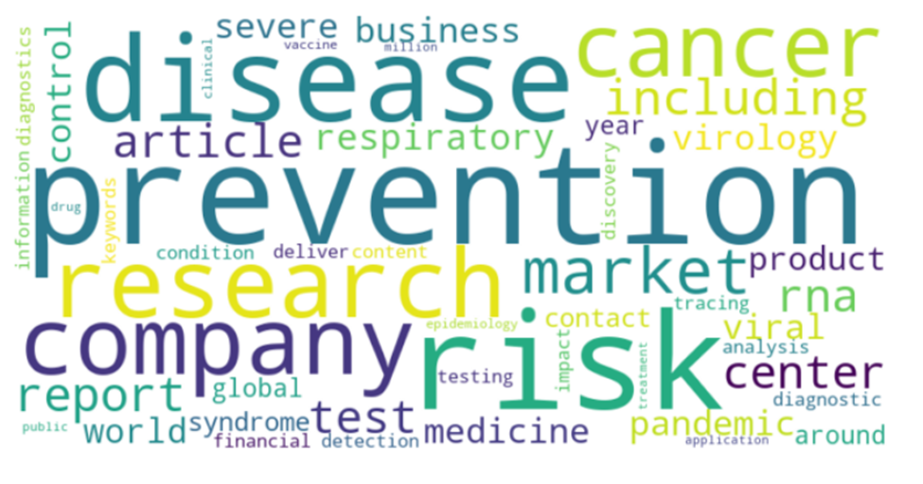
Phase-3
POSITIVE
Negative

Slide 26
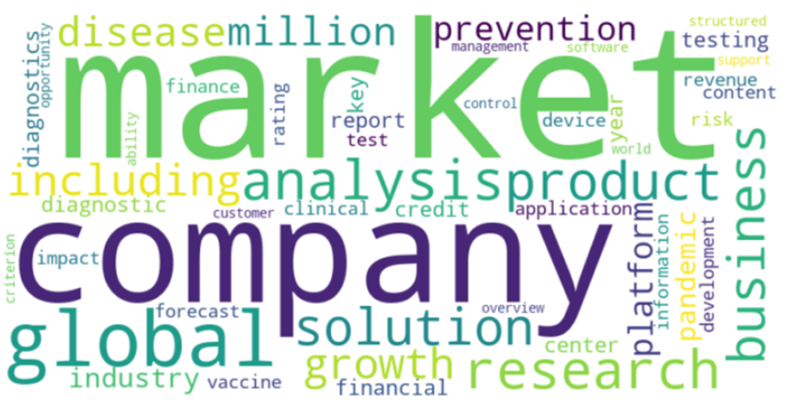
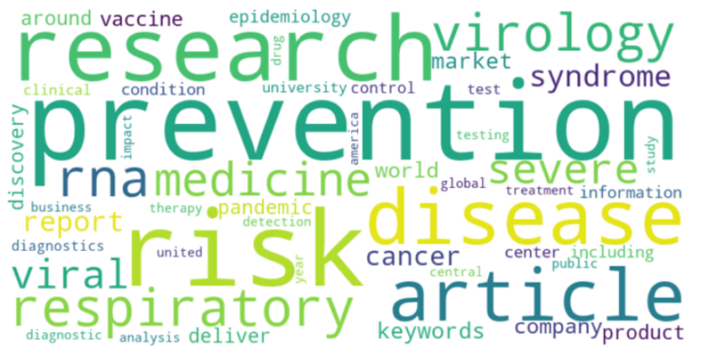
Phase- 4
POSITIVE
Negative

Slide 27
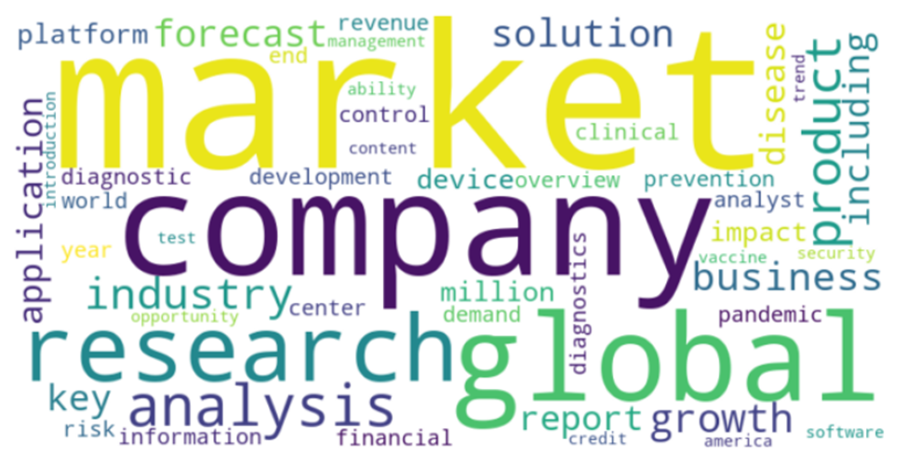
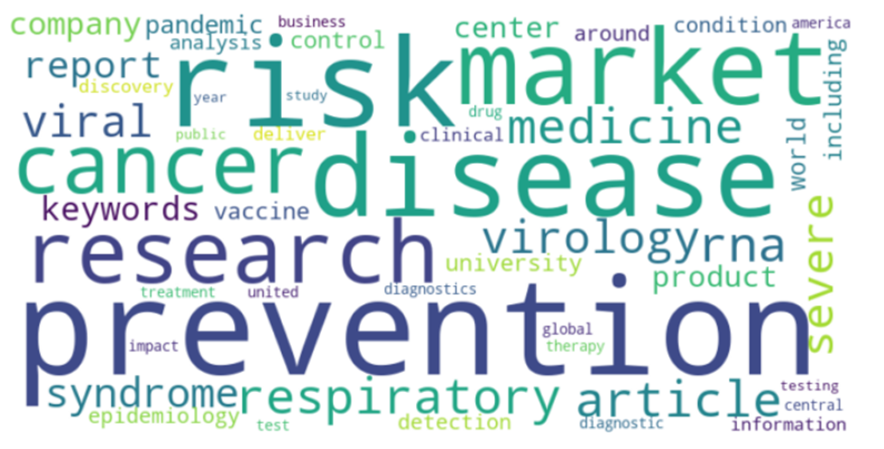
Phase- 5
POSITIVE
Negative

Slide 28
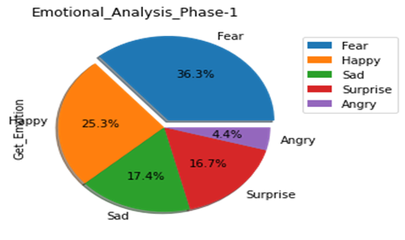
Emotion Analysis
Continued manually labeling tweets for Emotions:
Happy, Surprised, Angry, Sad, Fear, None
Labeled 1500 Tweets

Slide 29
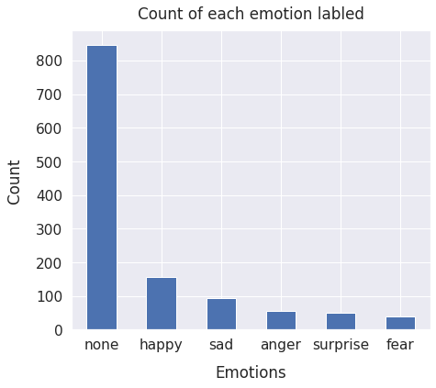
Class Distribution
‘None’ emotion dominates labeling; signifies neutral tweets
‘Happy‘ slightly higher than ‘sad’, aligns with sentiment
Minority classes: ‘Anger’, ‘Surprise’, ‘Fear’

Slide 30
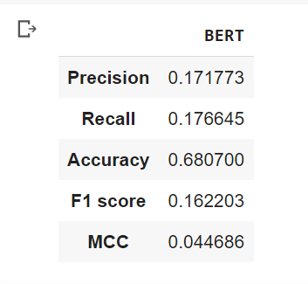
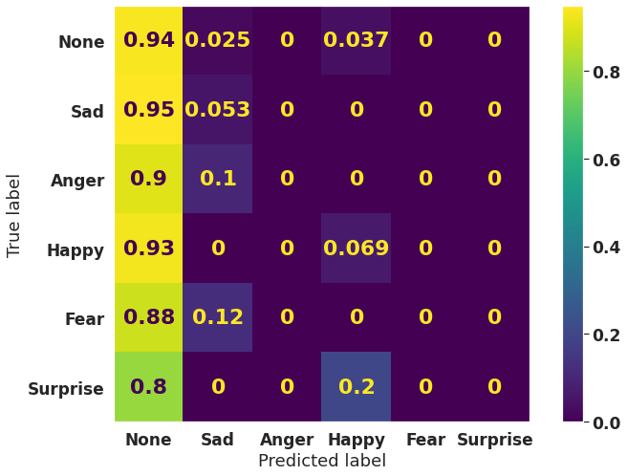
Modeling - DistilBERT
Potential fixes to the issue faced here:
Labeling more data
Treat the data imbalance using downsampling techniques for ‘None’ class

Slide 31
Next Steps
Run language models on combined dataset for Sentiment Analysis, DistilBERT promising
Improve emotion classification performance using sampling techniques and aim for better results

Slide 32
Thank You!
Questions/Comments?

